Slide 1

01
HACKATHON MIRAKL - UC 3
Rare AI talent is invisible through classic search. The signals exist — they're just not actionable yet.
LAURENT Louis, LESCURE Quentin, LIMEM Achraf, METCHAT Chahine
Notes:
We reframed UC3 as a market intelligence challenge: help Mirakl detect talent pools and competitor hiring intent before the market becomes obvious.

Slide 2



Our thesis: find talent environments before individual profiles.
02
Signal-first approach
Infer talent density
Recruiter-ready output
Start from companies, teams, and market signals — not LinkedIn keywords.
Infer talent concentration and latent seniority from public signals.
Generate recommendations, not raw data. Keep humans in control.
Human-in-the-loop by design — the system enhances TA judgment without replacing it.
Notes:
The system does not replace recruiters. It gives them better targets, better timing, and better messaging.

Slide 3

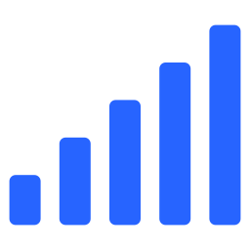





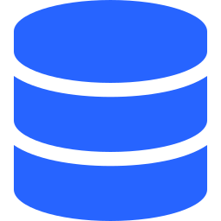

03
From public signals to sourcing & strategic intelligence
TA Query
Market Signals
Talent Pool
Scoring
Candidate
Intelligence
Competitor
Brief
n8n
Google Sheets
OpenAI Agents
Orchestration
MVP storage
Reasoning & classification
Notes:
The MVP is intentionally simple: n8n orchestrates workflows, Google Sheets stores data, OpenAI performs reasoning.

Slide 4

Step 1 — Start from a recruiter question
04
QUERY
"Find Senior AI Engineers in France for Mirakl"
Scope: France · Paris / Bordeaux / Remote | Domain: AI, ML, LLM, RAG, Production AI
Query Expansion
Downstream Driver
Natural Language
The system expands the query into equivalent profiles and target environments.
This single input drives all downstream signal collection and scoring.
Recruiters ask a real question — no complex tool configuration required.
Notes:
The user does not configure a complex tool. They ask a real TA question.

Slide 5
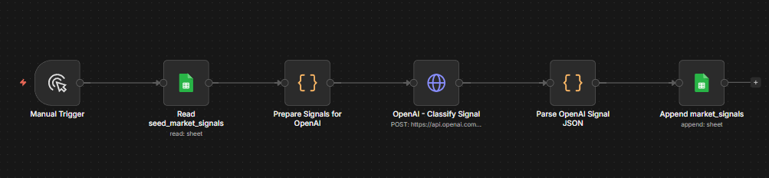

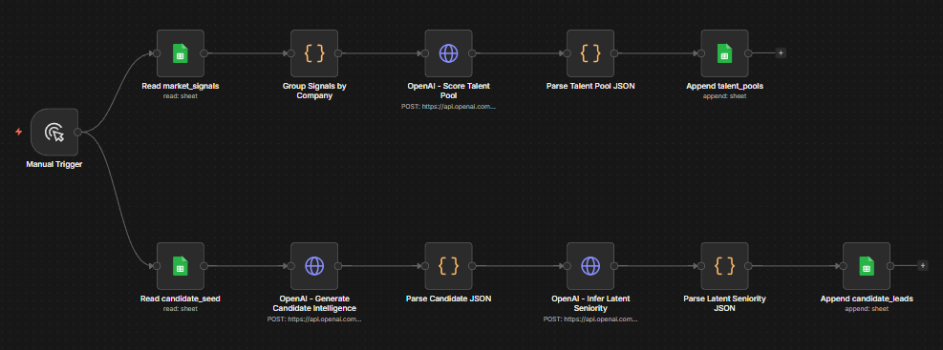
05
Step 2 — Capture and classify public market signals
workflow_1_collect_signals
Signal Types
Job posts, product news, engineering blog content, GitHub-style signals.
Action Labels
Act now · Watch · Ignore — so recruiters know what to prioritize instantly.
workflow_2_talent_intelligence
AI Interpretation
Each signal classified by type, relevance, confidence, and recommended TA action.
Intelligence Layer
Creates the raw intelligence layer that feeds talent pool scoring downstream.
Notes:
The value is not the data itself. The value is interpretation: what does this signal mean for Mirakl hiring?

Slide 6
Step 3 — Rank companies as talent pools
06
Talent density
France relevance
Signal strength
Mobility
Mirakl fit
PRIORITIZED TALENT POOLS
Dataiku
Dust
Criteo
Contentsquare
Doctolib
Smart Separation
Sourcing Actions
Separates 'interesting company' from 'actionable sourcing opportunity.'
Each company receives a recommended action. Recruiters know where to search first.
Notes:
This is where the system moves from sourcing lists to strategic sourcing priorities.

Slide 7


07
Step 4 — Generate recruiter-ready candidate intelligence
Lead Data
Why Detected
LinkedIn URL, company, title, fit score, and confidence level.
Each lead includes reasoning and a personalized outreach angle.
Latent Seniority
Outreach Draft
Detects seniority from tenure, stale profiles, and strong company context.
Recruiters get a first message draft, marked for manual validation.
Notes:
We are not claiming full automation. We generate high-quality recruiter inputs that remain human-validated.

Slide 8

Step 5 — Detect competitor hiring intent
08
COMPETITOR EXAMPLE
Dataiku
Strategic Radar
Key signals summarized & talent strategy interpreted
Predicted next hiring moves
This turns Talent Acquisition into a strategic radar — not only a sourcing function.
Concrete recommended actions for Mirakl TA
Notes:
This is the second required UC3 output: strategic competitor intelligence.

Slide 9

Agent accelerates judgment. Human owns the relationship.
09
Agent does
Human owns
Collects and classifies market signals
Scores talent pools by relevance
Infers latent seniority
Drafts outreach angles
Generates competitor intelligence briefs
Validates identity and relevance
Ensures compliance
Decides timing and messaging
Owns the relationship strategy
Final outreach decision
Notes:
The product is human-in-the-loop by design. It enhances TA judgment without replacing it.

Slide 10



MVP limits are clear — and productizable
10
Demo-seeded data
No direct LinkedIn scraping
Candidate data must be validated before real outreach.
Compliance-first: no scraping for legal and ethical reasons.
Signal gaps
Confidence scoring
Public signals can be incomplete, stale, or ambiguous.
Reduces overclaiming but does not remove uncertainty.
Next: connect ATS, Talent CRM, LinkedIn Recruiter export, compliant providers
Notes:
We chose credibility over fragile scraping. The intelligence layer is functional and ready to connect to approved data sources.

Slide 11
FinOps: lightweight MVP, scalable by design
11
n8n Orchestration
Google Sheets / Airtable
OpenAI Usage
Low fixed cost or self-hosted
Negligible MVP cost
Classification & generation calls
MVP
PILOT SCALE
€20 – €100/mo
€150 – €500/mo
Weekly runs, single role scope
Multi-role, multi-company, higher refresh
Notes:
The biggest cost is not infrastructure. It is data enrichment volume and frequency.

Slide 12





12
Concrete value for
Mirakl Talent Acquisition
Build a France AI talent map for priority roles
Monitor competitors: Dataiku, Dust, Criteo, Contentsquare, Doctolib
Generate recruiter-ready shortlists with outreach angles
Detect under-visible senior profiles earlier than classic sourcing
Turn public market signals into weekly TA intelligence
A practical TA operating system: sourcing today, competitor foresight for tomorrow.
Notes:
The result is a practical TA operating system: sourcing execution today, competitor foresight for tomorrow.

